Slide 1
Capstone Project - The Battle of Neighborhoods
Selecting the best location to open an Indian restaurant IN Manhattan, New York

Slide 2
Introduction/Business Problem
The City of New York is famous for its excellent cuisine. It's food culture includes an array of international cuisines influenced by the city's immigrant history.
Indian restaurants have become so popular in the United States now it seems that there is one on every corner, not only in major cities but also in smaller cities. Starting an Indina restaurant can be a great business opportunity, but you need to distinguish yourself from others to enjoy long-term success.

Slide 3
Business Problem
My client wants to open his business in Manhattan area, so I focus on that borough during my analysis. We define potential neighborhood based on the number of Indian Restaurants which are operating right in each neighborhood. Manhattan has full potential but also is a very challenging district to open a business because of high competition. New Indian Restaurant should be open in an area that inadequate neighborhood in this way the bar can attract more customers. Therefore, this analysis necessary to ensure that we have enough customers and that we are not so close to other similar places.

Slide 4
Data Selection
To identify the characteristics of our competitors' venues in Manhattan, we would first need to find out the number of Indian Restaurants in Manhattan currently and their location.
We then used Google Map API to find their geographic coordinates based on their postal code addresses.
In Manhattan, 1997 Indian Restaurants are currently operating.

Slide 5
Methodology
Addresses are converted into their equivalent latitude and longitude values.
Foursquare API is used to explore neighborhoods in Manhattan, New York.
After that, explore function to get Indian restaurant categories in each neighborhood.

Slide 6
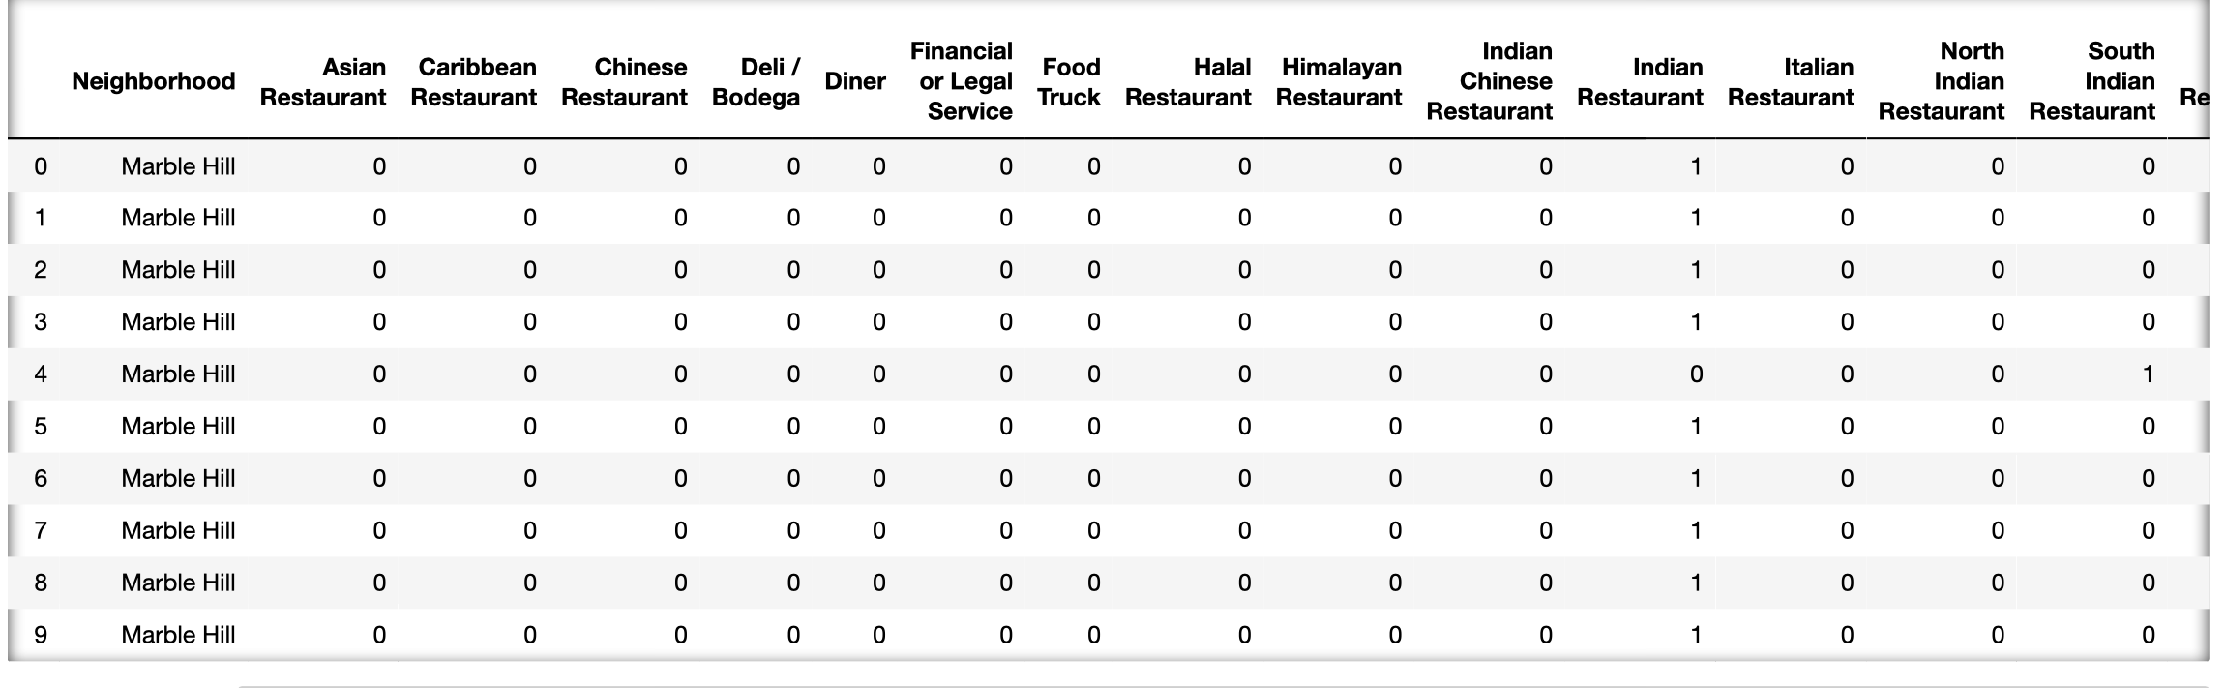
Methodology

Slide 7
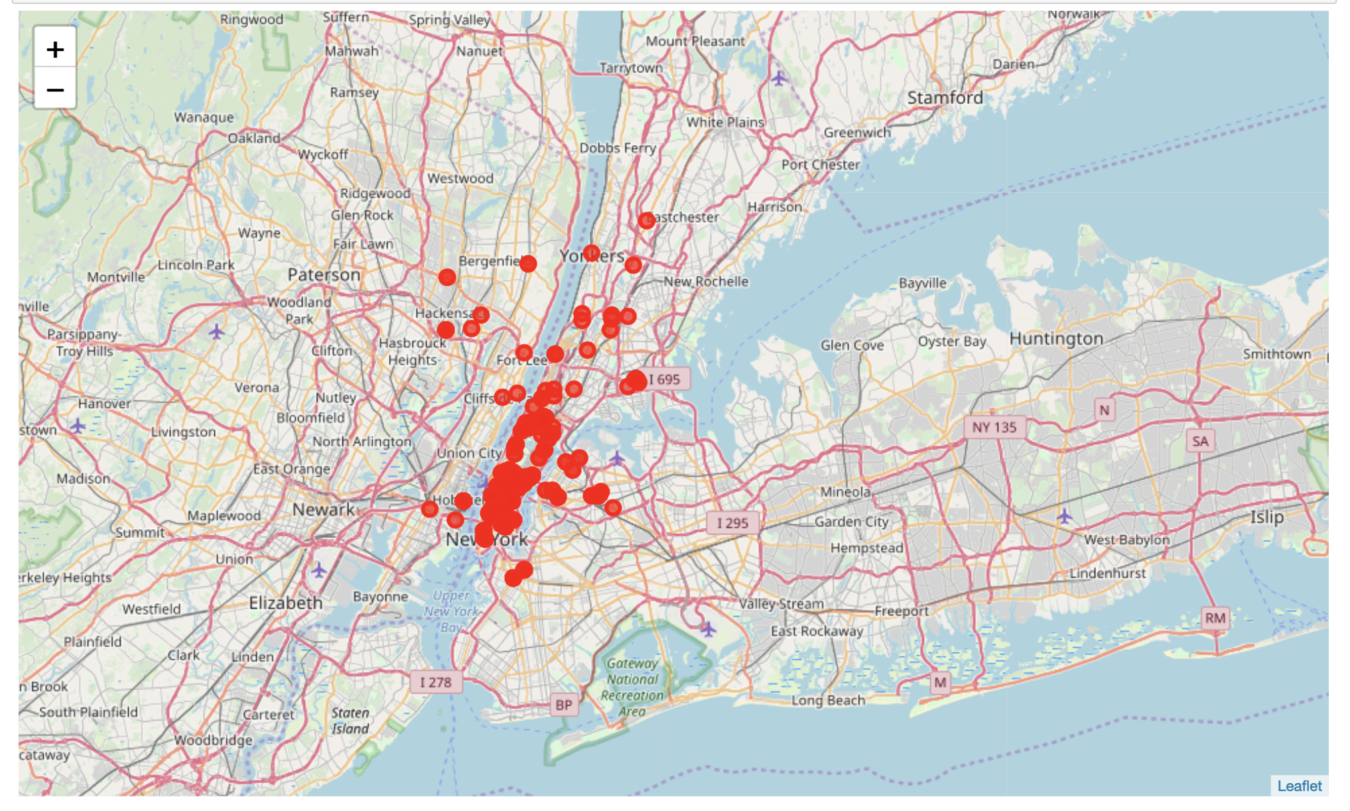
Methodology
Indian Restaurant in Manhattan

Slide 8
Methodology
Then using this feature to group the neighborhoods into clusters K-means clustering algorithm will be use to complete this task. And also, the Folium library to visualize the neighborhoods in Manhattan and its emerging clusters.

Slide 9
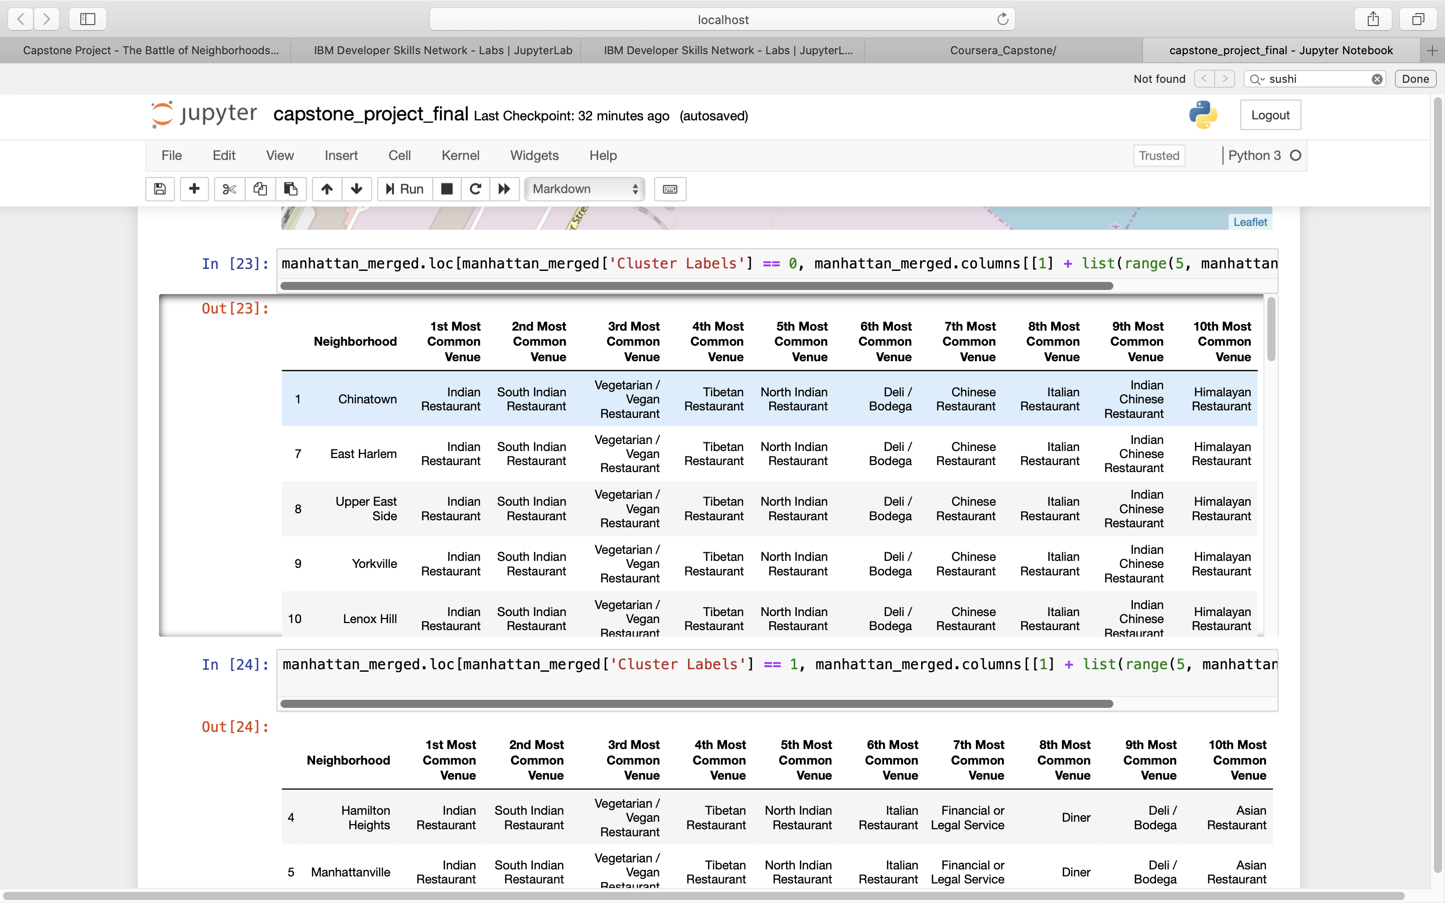
Results
Using K-mean to clustering data area with less number of Indian Restaurants
Cluster 0

Slide 10
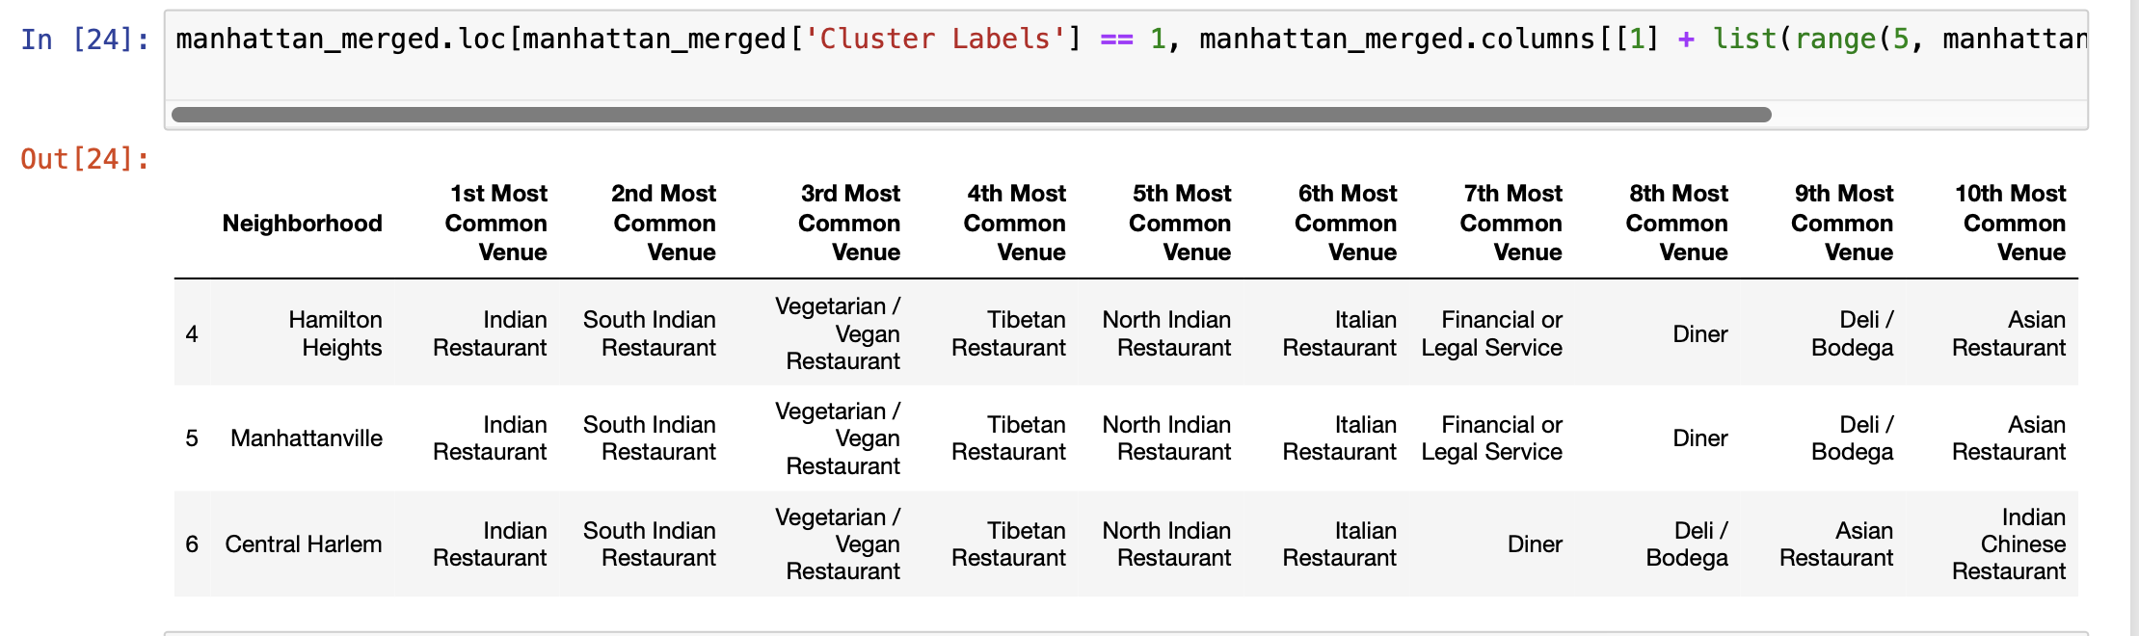
Result
Cluster 1

Slide 11
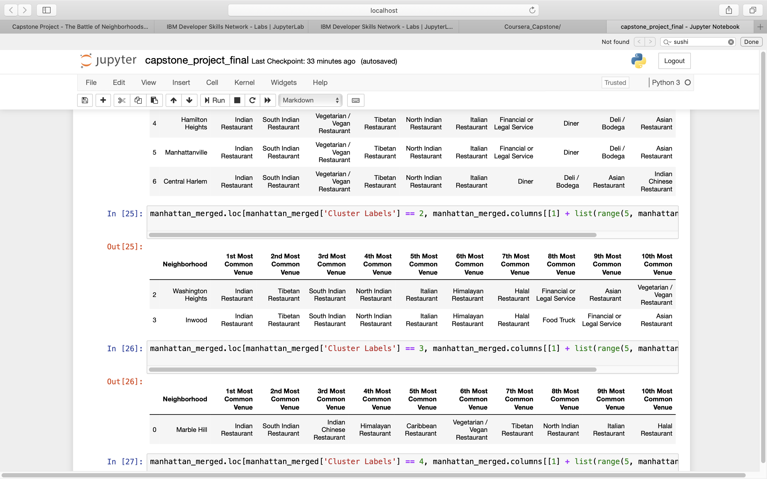
Result
Cluster 2

Slide 12
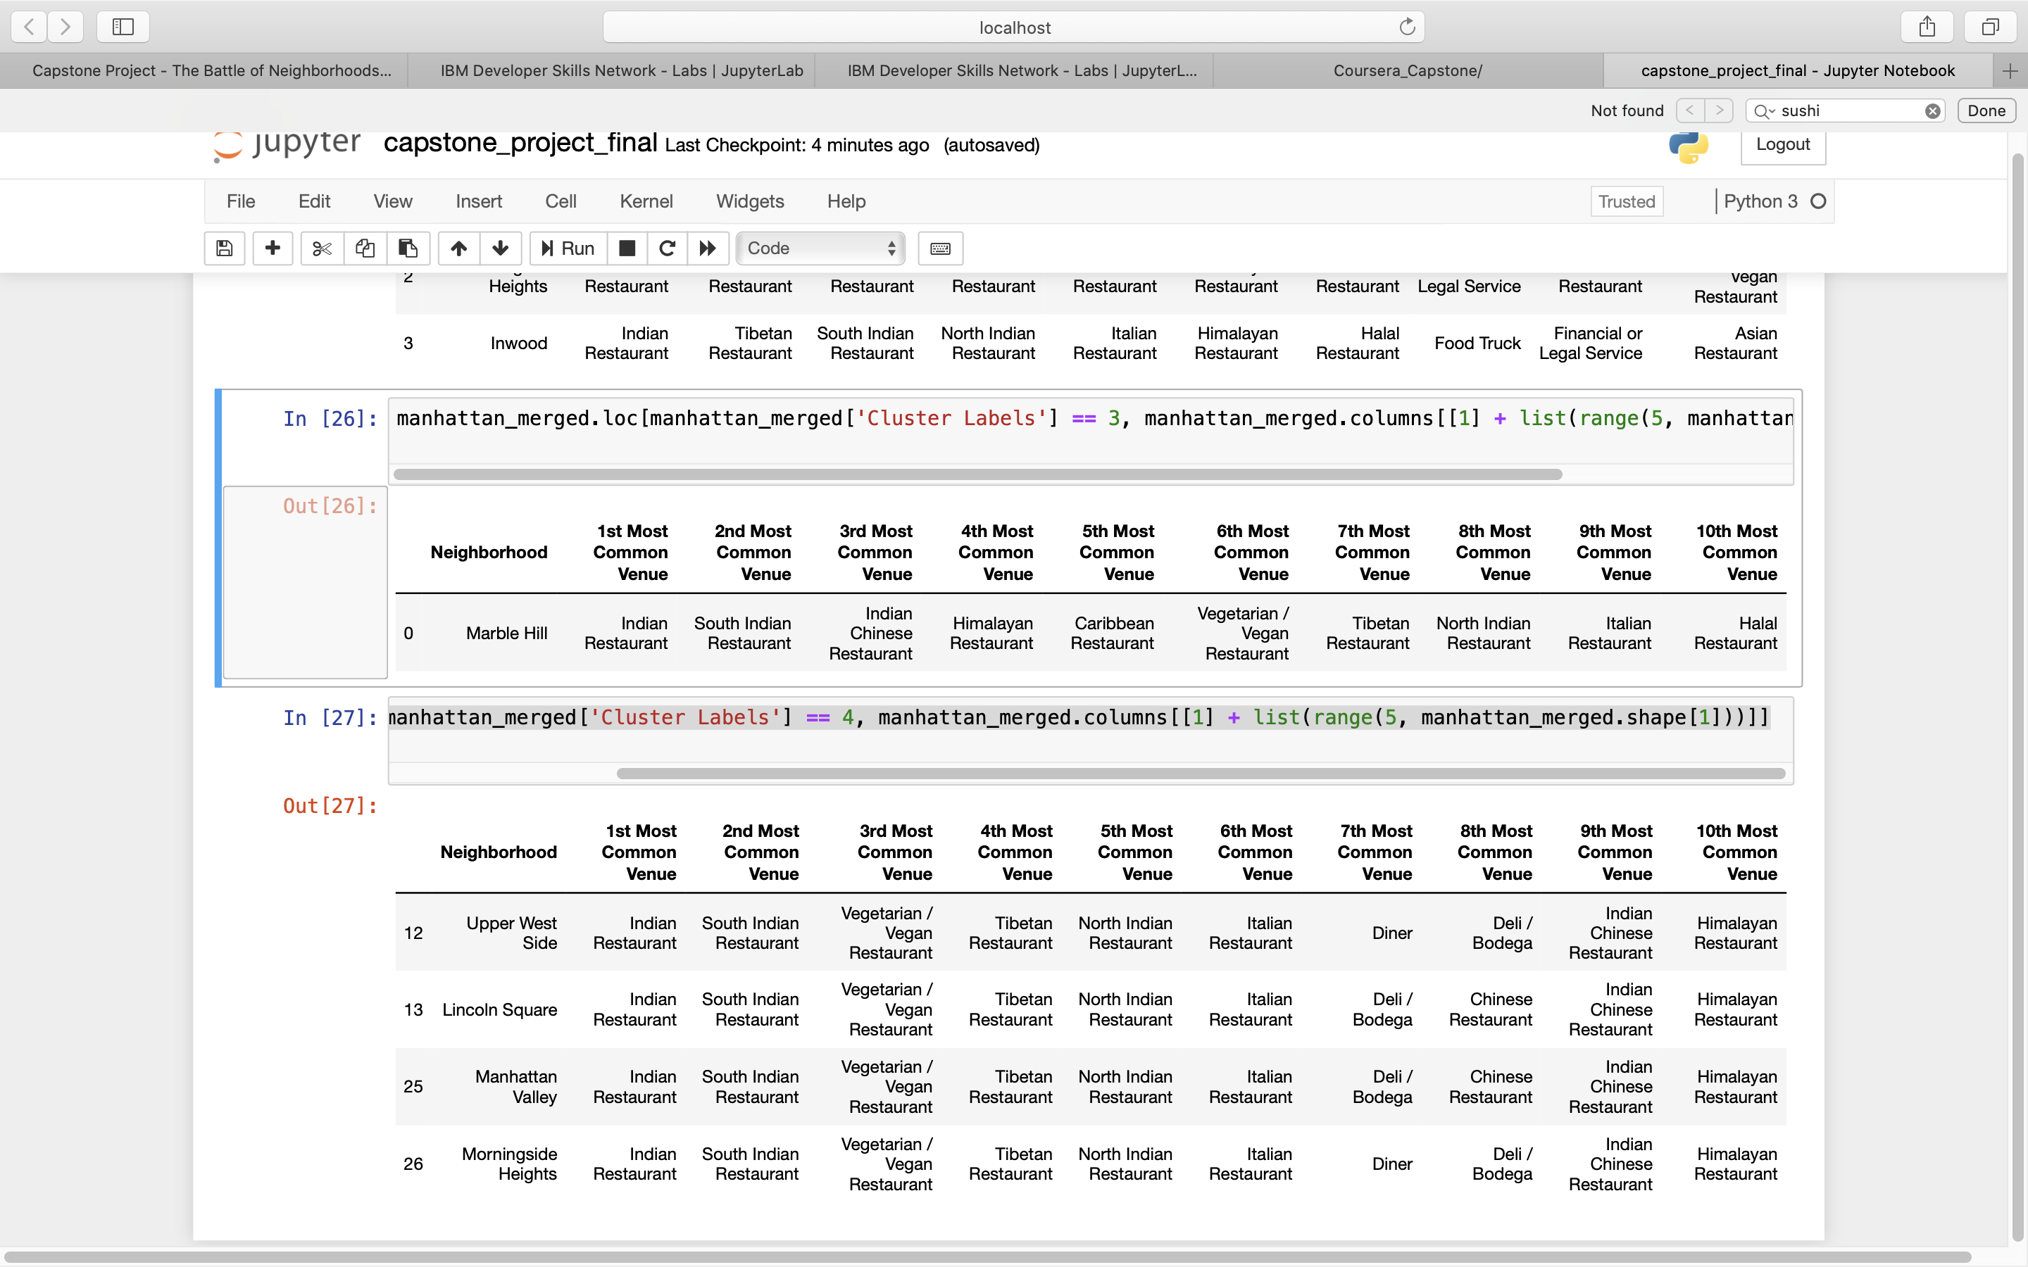
Result
Cluster 3

Slide 13
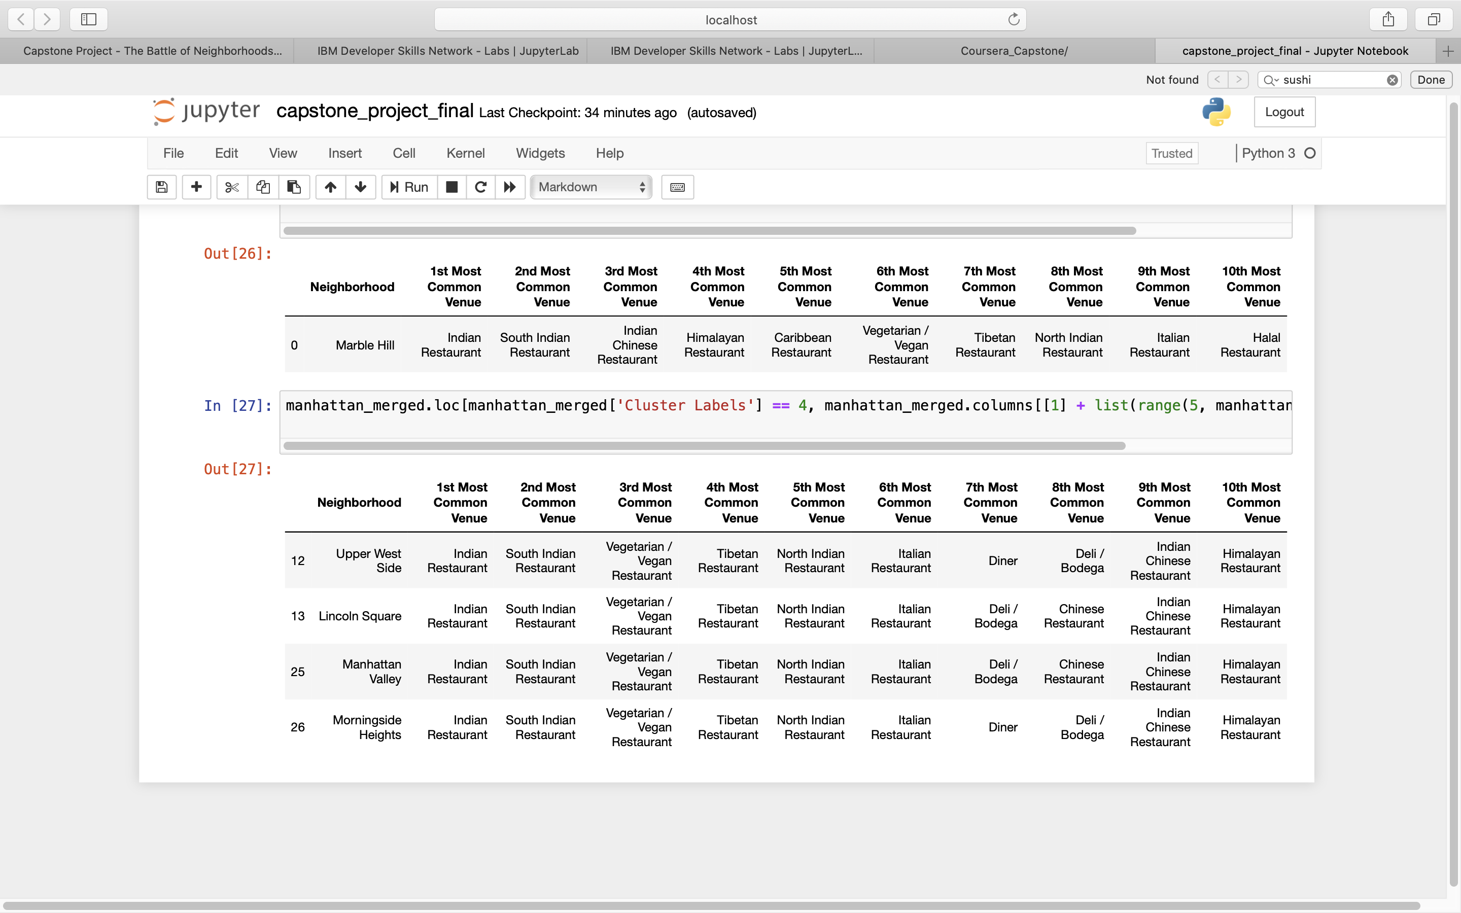
Result
Cluster 4

Slide 14
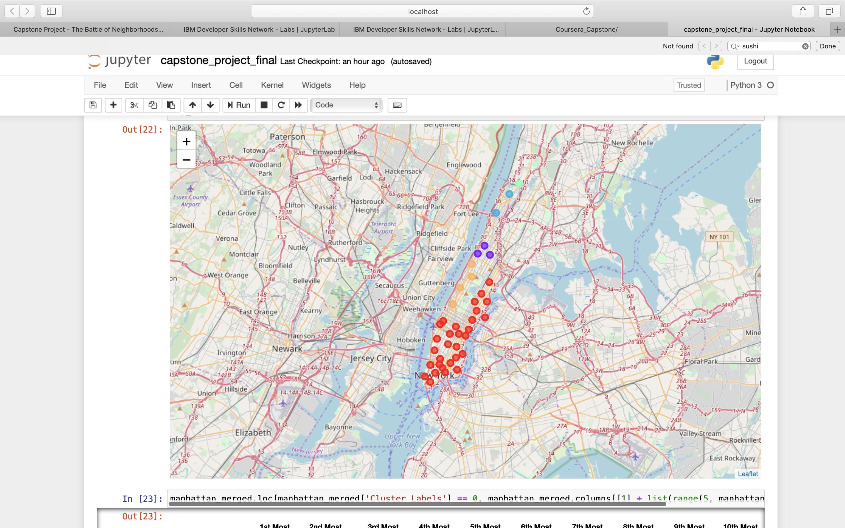
Result

Slide 15
Result
Based on data frame analysis and discussion as above in this document, Cluster 3 (Marble Hill ) and Cluster 4 (Upper West Side, Lincoln Square, Manhattan Valley and Morningside Heights) areas are the best places to open a new Indian Restaurant business

